Slide 1
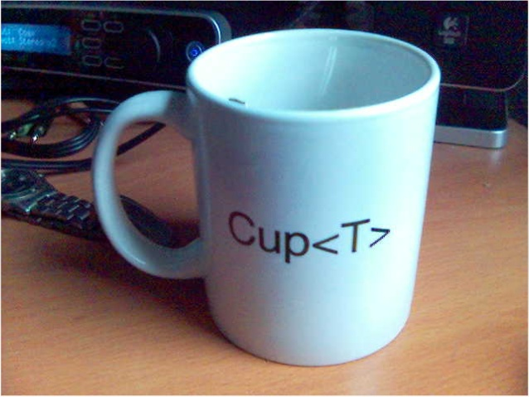
Java Generics
Session today’sSession = new Session<Wednesday>(“Java Generics”,”Deshraj Singh”);

Slide 2

Agenda
Introduction
History
Advantages
Terminologies
Rules Related To Generics
Code Examples

Slide 3
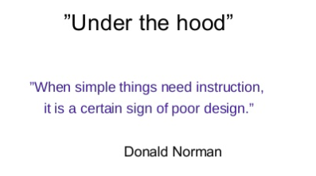
Introduction
Generics - An enhancement to the type system that supports operations on objects of various types while providing compile-time type safety.
They allow a type or method to operate on objects of various types while providing compile time safety.

Slide 4
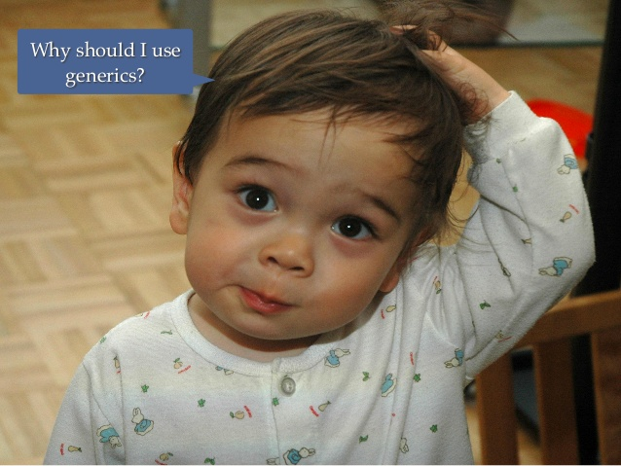
Why?
If you are to do some serious engineering
Compile-Time Type Checking : let the compiler catch more potential bugs
Faster Runtime Execution
To Increase robustness and reduce Type Casting

Slide 5
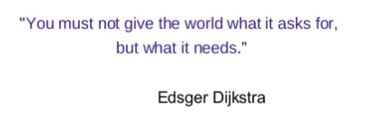
History
Generic types were introduced in J2SE 5.0 in 2004 with following intents
Additional Type Safety
To reduce the need of casting
2. Legacy Code Interoperability

Slide 6

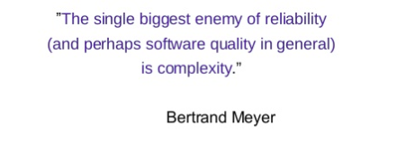

Slide 7
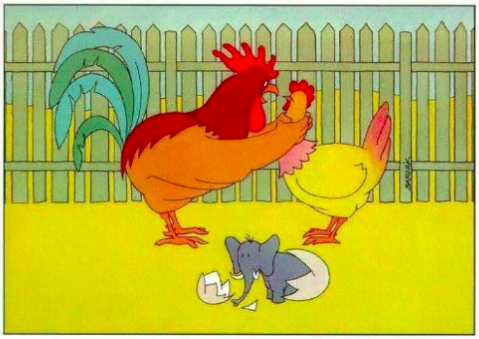
Type-safety
Before Generics -
List nameList = new ArrayList();
nameList.add(123.45); // no issue
After Generics-
List<String> nameList = new ArrayList<>();
nameList.add(123.45); // Compilation error

Slide 8



Reduced Type Casting
Before Generics:
After Generics :

Slide 9

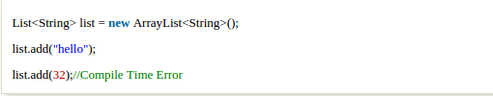
Compile-Time Checking
The good programming strategy says it is far
better to handle the problem at compile time
than runtime.

Slide 10
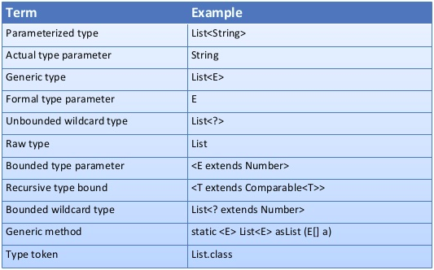
Terminologies

Slide 11

Rules
Only classes, interfaces and methods can be defined as generic
Enums and inner classes cannot be declared as generic
By Convention we use single letter to define formal type parameters
E - > Element
K -> Key
V -> Value
T ->Type etc.
Naming follow the same rules as variable declaration

Slide 12
Rules contd………..
Constructors doesn’t specify formal type parameters
Class Node<E>{
Node<E>(){............ } // wrong
}
Formal type parameters cannot be used to create objects
E reference = new E(); //wrong
A formal type parameter cannot be used in static context.

Slide 13

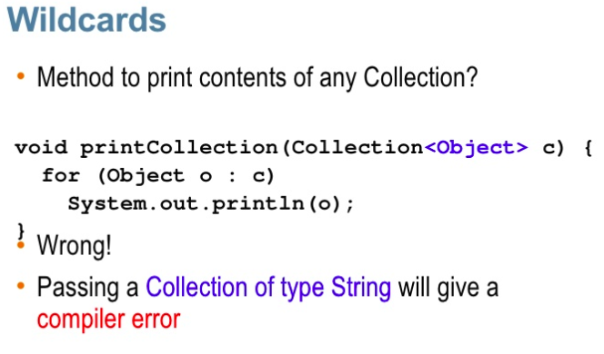
Wild Cards and Type Erasure

Slide 14


Slide 15


